Slide 1
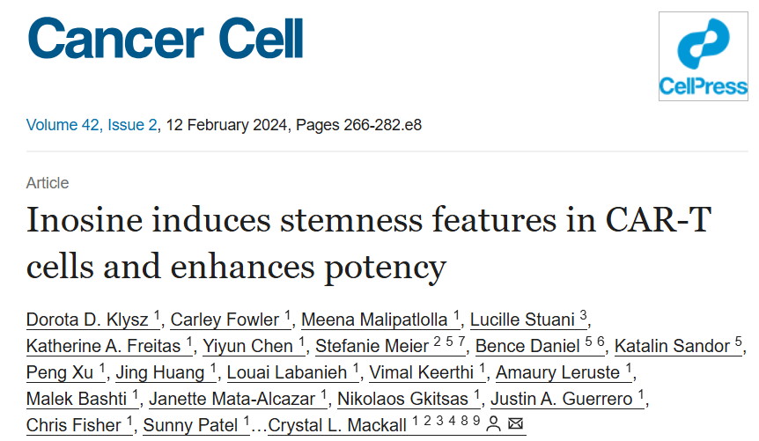
Overexpression of ADA-1 to enhance CAR-T Therapy
Advanced Omics Final Presentation
2024-12-11
Arden Edgerton

Slide 2
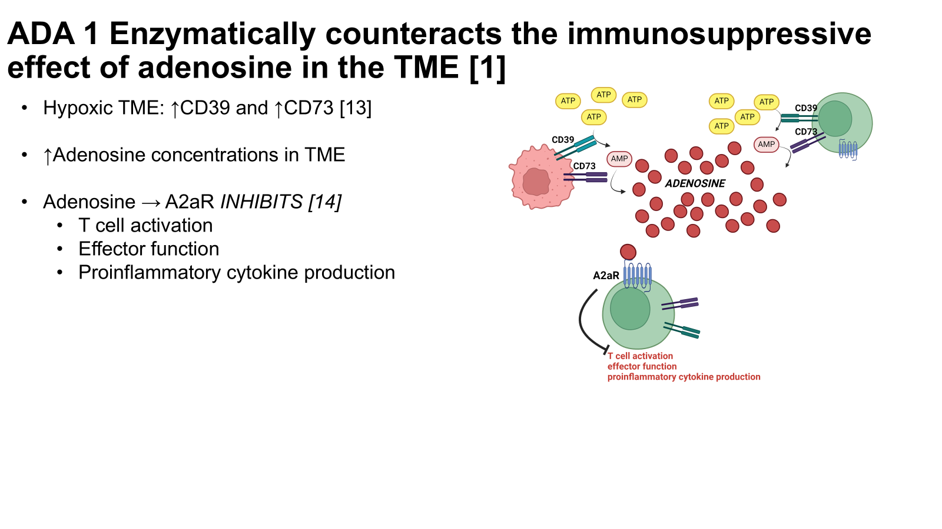
CAR-T Therapy has dramatically altered the approach to cancer therapy—however has limitations in targeting solid tumors
Challenge of adenosine in tumor microenvironment

Slide 3
CAR-T Therapy has dramatically altered the approach to cancer therapy—however has limitations in targeting solid tumors
Some groups have targeted CD39/CD73/A2aR
Previous groups show blocking enzymatic activity of CD39, CD73 or blocking A2aR are effective in evading immunosuppressive effects of adenosine…[20-22]
However, capitalizing on ADA-1 enzymatic activity has shown to have a greater effect on CAR-T function [2]

Slide 4
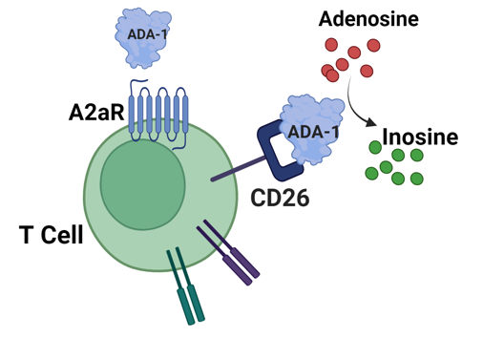
CAR-T Therapy has dramatically altered the approach to cancer therapy—however has limitations in targeting solid tumors
Approach: Introducing overexpression of ADA-1into CAR_T cells to enhance efficacy against solid tumors
My project: Used RNAseq data to look at how this alters the groups based on previous results

Slide 5
Samples Used for Omics Project
Short Hand Sample ID | Sample ID from NCBI | Type of Edit | Donor | ncbi_ssr | Zipped File Name
ada_car_d48 | ADA-OE HA-CAR-T cells, donor 48 | ada-oe | 43 | SRR27237076 | data/SRR27237076.fastq.gz
car_d48 | control HA-CAR-T cells, donor 48 | control | 48 | SRR27237077 | data/SRR27237077.fastq.gz
ada_car_d43 | ADA-OE HA-CAR-T cells, donor 43 | ada-oe | 48 | SRR27237081 | data/SRR27237081.fastq.gz
car_d43 | control HA-CAR-T cells, donor 43 | control | 43 | SRR27237082 | data/SRR27237082.fastq.gz

Slide 6
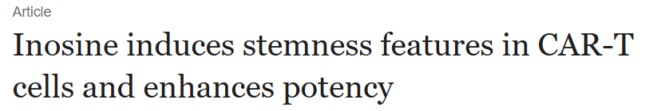
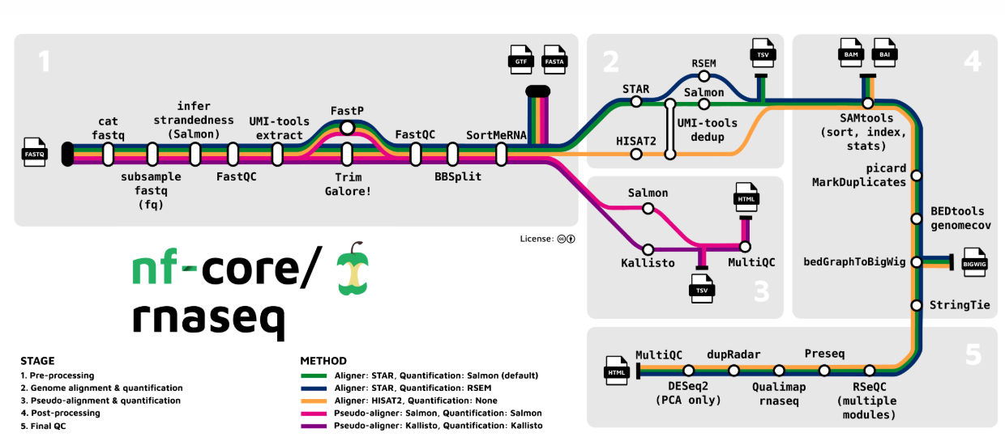


Advanced Omics Project Approach
RNA seq data from paper
Download and input into NF core
Visualize using python to do differential expression analysis
Import subsets of differentially expressed genes into Enrichr for pathway analysis

Slide 7
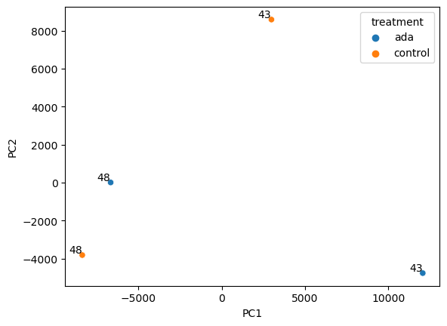
Dimensionality Reduction
# Result from PCA Plot:
The samples of similar conditions should group together.
However we do not see this as the case.....it could be because we have a really small number of samples and there could be variability between the 2.
This is evidence that maybe there isn't a big effect of ADA-1 over expression. Or it could be that the sample size is too low.

Slide 8
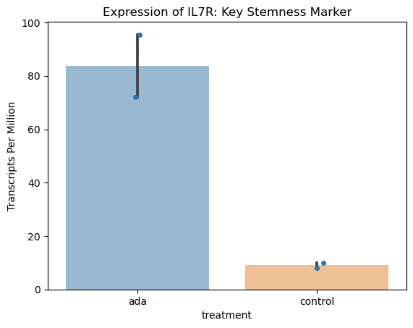
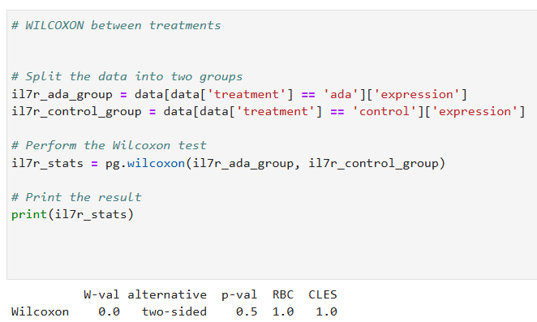
Visualization of Hand Selected Genes Using: salmon.merged.gene_tpm.tsv
Given that the paper claims that the expression of ADA-1 increases stem like phenotype I took a look at IL7R gene expression (plays a crucial role in T cell development and maintenance of the stem-like state.
Based on the graph looks meaningful, however does not reach statistical significance based on Wilcoxon test

Slide 9
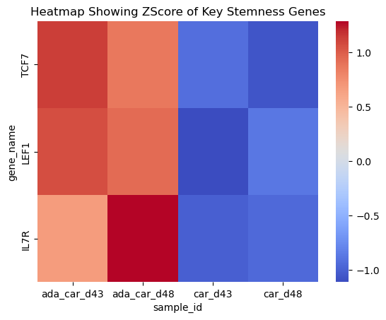
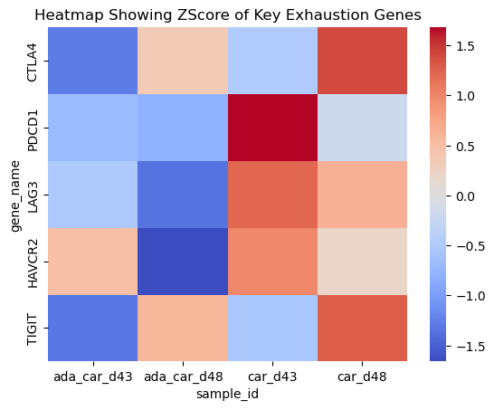
Visualization of Hand Selected Genes Using: salmon.merged.gene_tpm.tsv
Hand Selected Key T Cell Stemness Markers
Hand Selected Key T Cell Exhaustion Markers

Slide 10
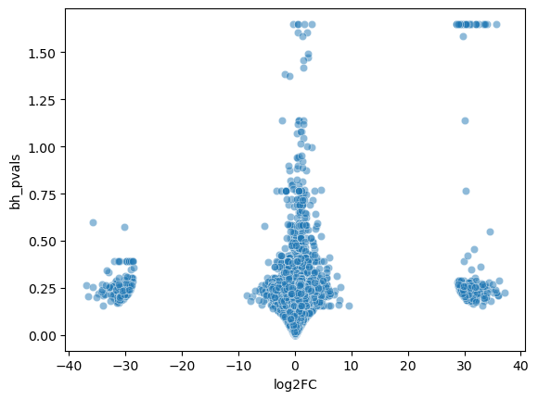
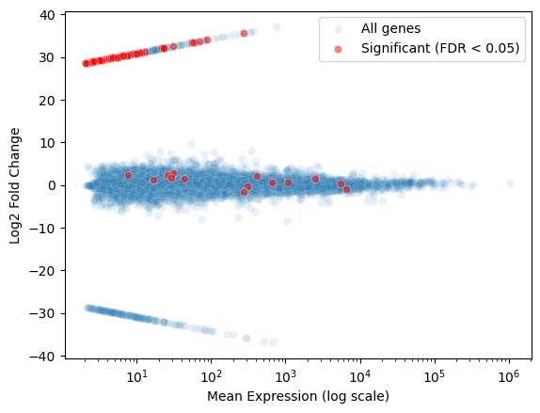
Pairwise Comparison: ADA vs. Control Using: salmon.merged.gene_tpm.tsv
Volcano Plot
Scatter Plot

Slide 11
Pairwise Comparison: ADA vs. Control Using: salmon.merged.gene_tpm.tsv
2
1
# Filter the Differential Expression DF
Significance
Log2FC > 20
Log2FC between -10 and 10
3

Slide 12
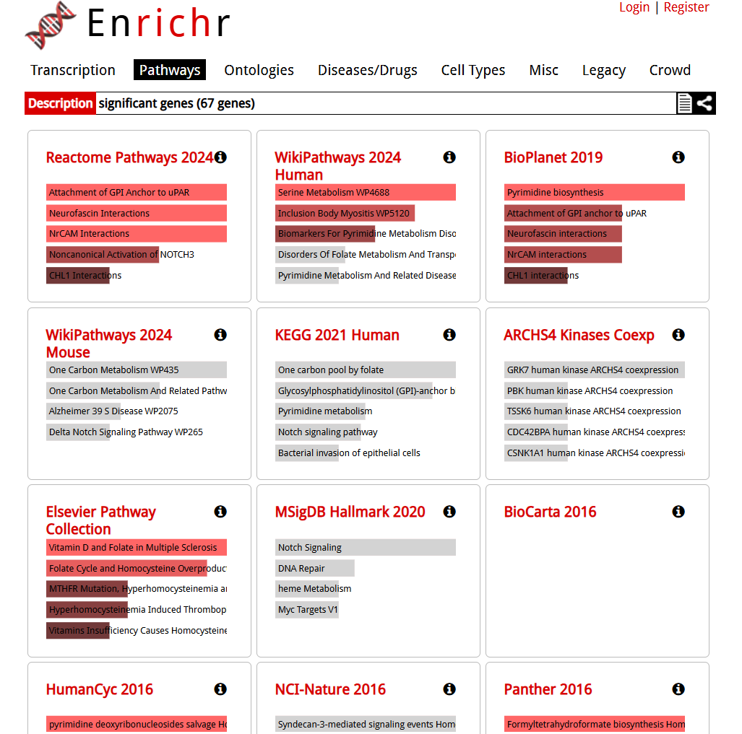
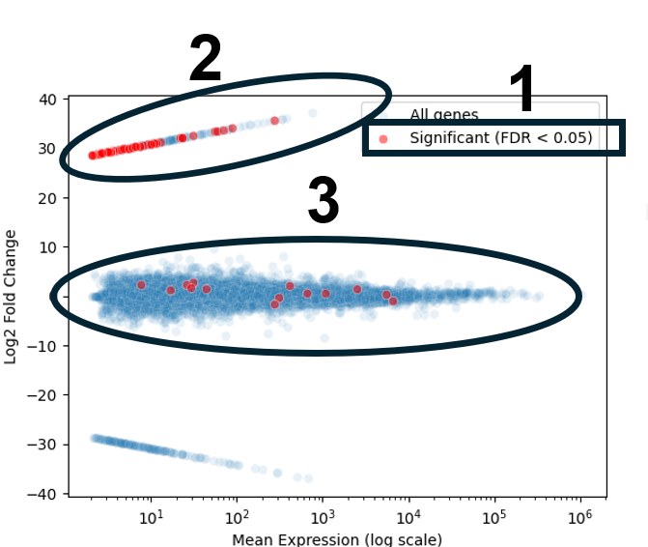
Pathways Enriched Filtered on significant genes
https://maayanlab.cloud/Enrichr/enrich?dataset=33d0dcb88046b1120da1c0be2186693b

Slide 13
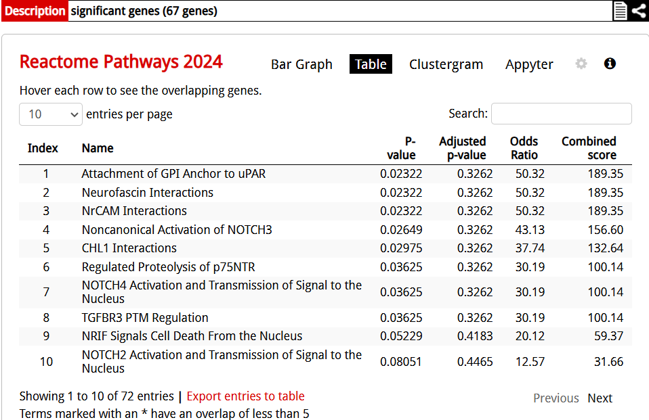
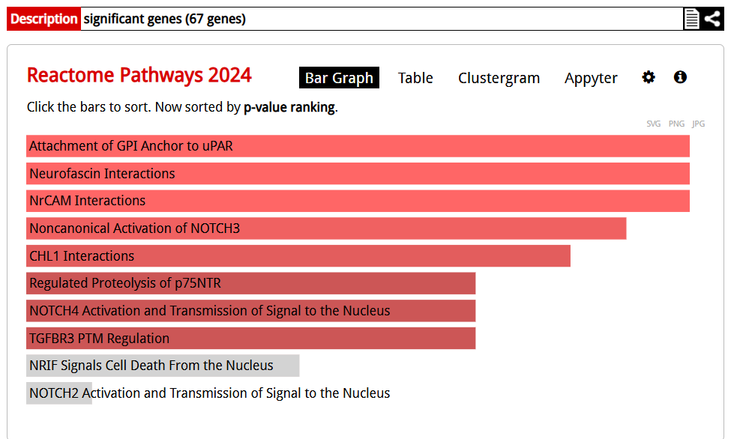
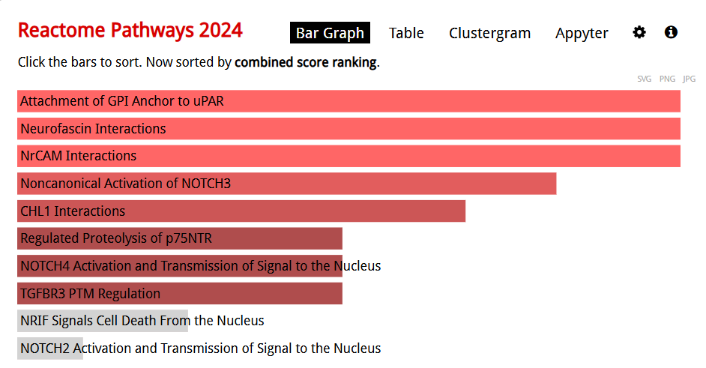
Pathways Enriched Filtered on significant genes
https://maayanlab.cloud/Enrichr/enrich?dataset=33d0dcb88046b1120da1c0be2186693b

Slide 14
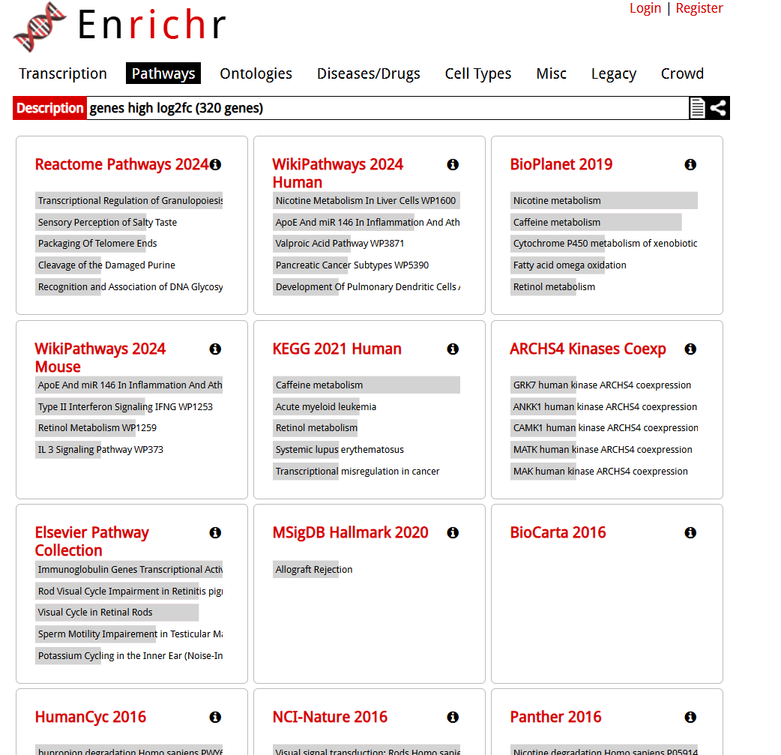
Pathways Enriched Filtered on log2fold high
https://maayanlab.cloud/Enrichr/enrich?dataset=141453d3c0957b6d05cbeabb163d0532

Slide 15
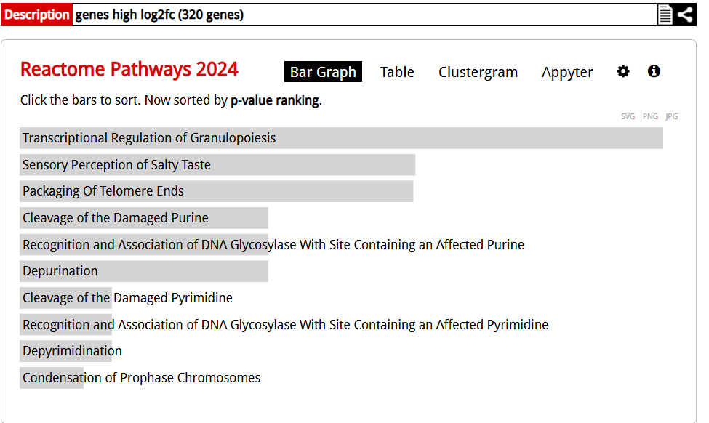
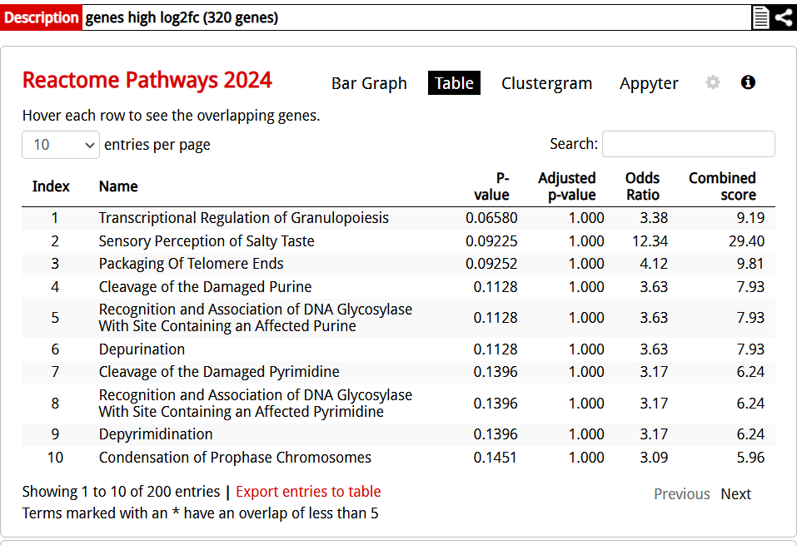
Pathways Enriched Filtered on log2fold high
https://maayanlab.cloud/Enrichr/enrich?dataset=141453d3c0957b6d05cbeabb163d0532

Slide 16
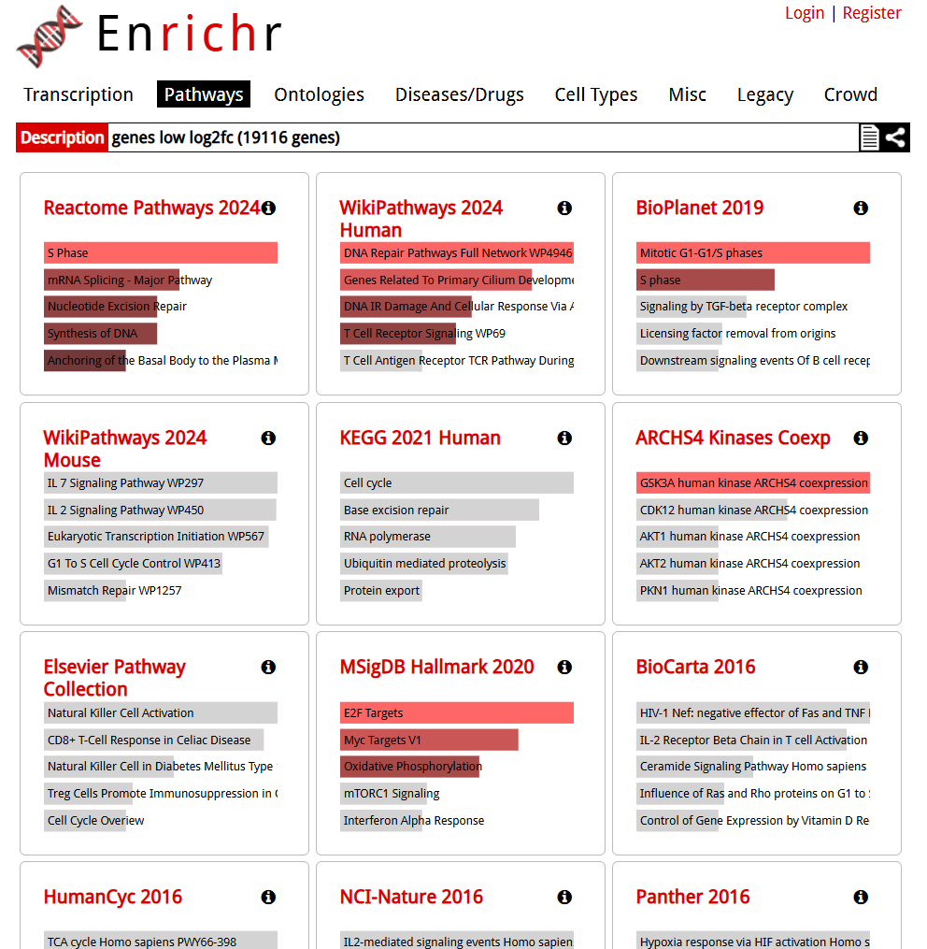
Pathways Enriched Filtered on log2fold low
https://maayanlab.cloud/Enrichr/enrich?dataset=cea5187401a0a118eac7ede7a3b9cc55

Slide 17
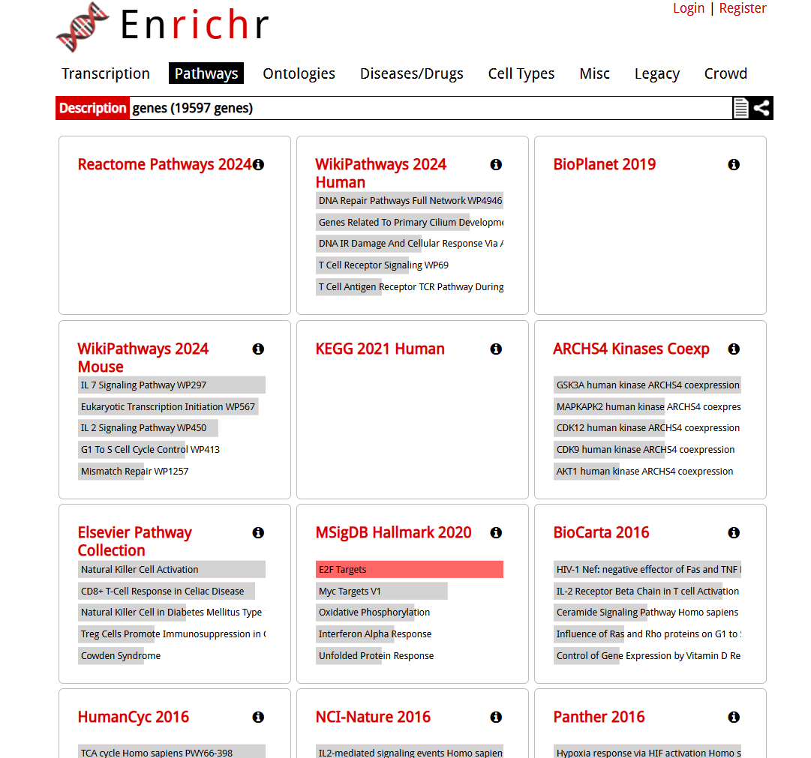
Pathways Enriched Filtered on all differentially expressed genes
https://maayanlab.cloud/Enrichr/enrich?dataset=db36e511acbdd2ab274243e86b2d457e

Slide 18
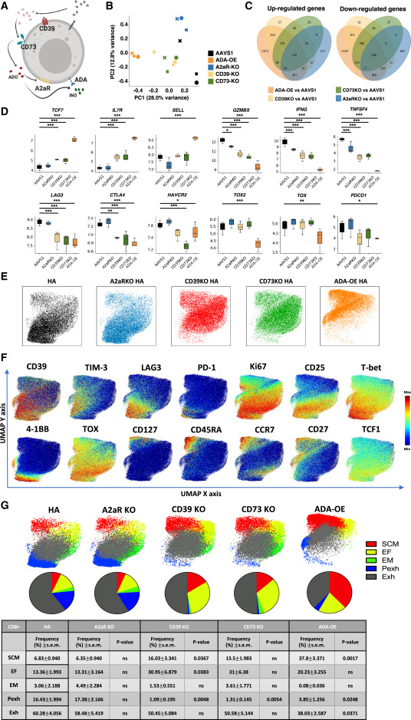
Figure 2. Overexpression of adenosine deaminase (ADA-OE) increases features of stemness and decreases terminal differentiation
Notes:
Figure 2. Overexpression of adenosine deaminase (ADA-OE) increases features of stemness and decreases terminal differentiation
(A) Schematic of immune suppression mediated by purinergic pathway. ADO- adenosine; A2aR-adenosine 2a receptor; CD39- ecto-ATP diphosphohydrolase-1; CD73- 5ʹ-ectonucleotidase; INO- inosine; ADA- adenosine deaminase.
(B) Principal component analysis (PCA) of bulk RNA-seq from control AAVS1KO HA-CAR-T cells or overexpressing Ado deaminase (ADA-OE) or deficient for A2aR, CD39, or CD73 15 days post-activation (n = 3 donors).
(C) Number of upregulated and down regulated genes in ADA-OE, CD39-KO, CD73-KO, and A2aR-KO conditions compared to AAVS1 controls.
(D) Boxplots showing log2TPM of T cell exhaustion and effector associated genes in CAR T cells profiled by bulk RNA-seq. The top, bottom, middle, and whiskers of the boxplot represents the upper quantile, lower quantile, median, and the rest of the distribution, respectively ∗p < 0.1; ∗∗p < 0.05; ∗∗∗p < 0.01 by DESeq2.
(E–G) UMAP analysis of day 15 CD8⁺ HA-CAR cells engineered as in (A). Expression of 26 markers was analyzed by CyTOF. 5,000 or maximum of CD8⁺ CAR-T cells from each donor (n = 4) were combined and colored by (E) genotype, (F) marker intensity or (G) subpopulation defined by FlowSOM algorithm. Pie charts show population frequencies defined using FlowSOM for each condition. SCM; stem cell memory, EF; effector, EM; effector memory, Pexh; progenitor exhausted, Exh, exhausted. Table shows the average frequencies and corresponding p values determined by paired two-tailed t tests. See also

